Slide 1

PCDSI0121 DS105-MACHINE LEARNING PROJECT Is Stock Price Predictable Using LSTM?
KANG BOON KIAT

Slide 2
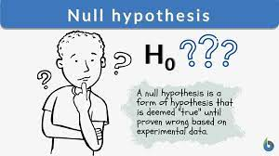
Hypothesis
Null Hypothesis: Many people believe that stock closing price is predictable and forecastable using general LSTM model with stock closing price.
Alternate Hypothesis: I believe that LSTM not able to predict and forecast stock price closing price by using stock closing price.
To test the hypothesis:
Implement the LSTM model to a stock data (Closing price)
Visualise the prediction and forecast result.

Slide 3
Content
Hypothesis
What is LSTM?
Hypothesis Testing
Conclusion to the Hypothesis Testing
Why Stock data is/not Predictable?
Difficulties and Take-away

Slide 4
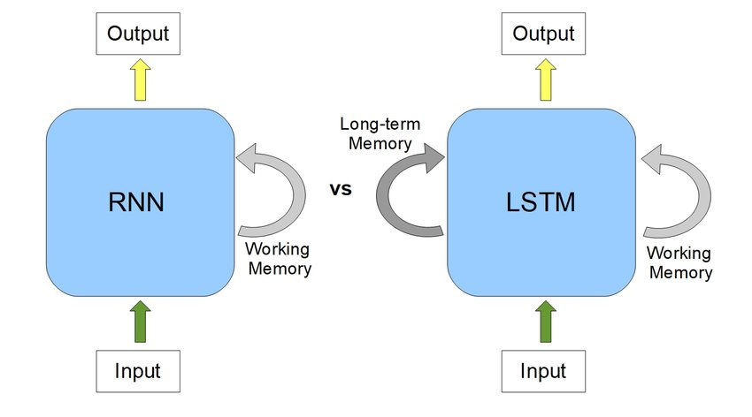
What is LSTM?
Long Short Term Memory Network is type of Recurrent neural network.
Unlike standard RNN, it is capable of learning long-term dependencies, especially in sequence prediction problems.
LSTM has feedback connections, i.e., it is capable of processing the entire sequential data, apart from single data points such as images.

Slide 5

Hypothesis Testing
LSTM Model Testing
Download dataset
Exploratory Data Analysis (EDA)
Building Model
Evaluation Test Model
Visualisation of the result

Slide 6
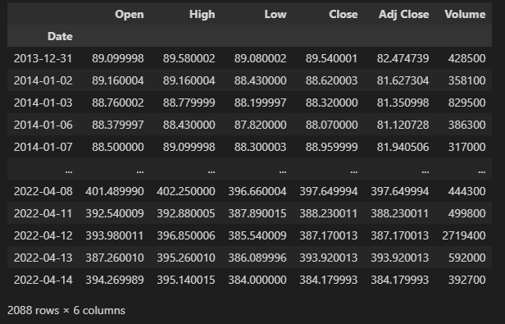
Download dataset
Stock data of Vanguard Information Technology Index Fund ETF (VGT)
Dated 2013-12-31 – 2022-04-14

Slide 7
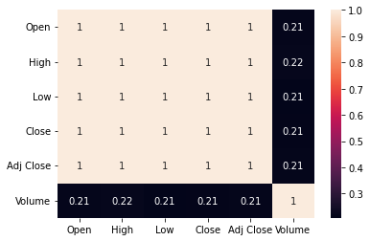
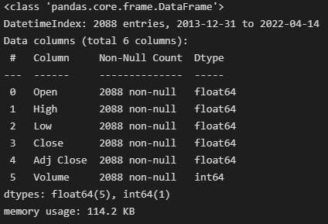
Exploratory Data Analysis (EDA)
All data are non-object and correlations all are ‘1’. It is a standard stock dataframe.

Slide 8
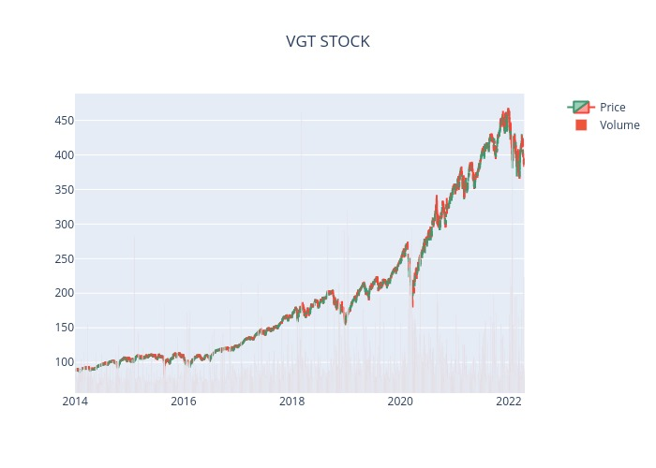

Slide 9
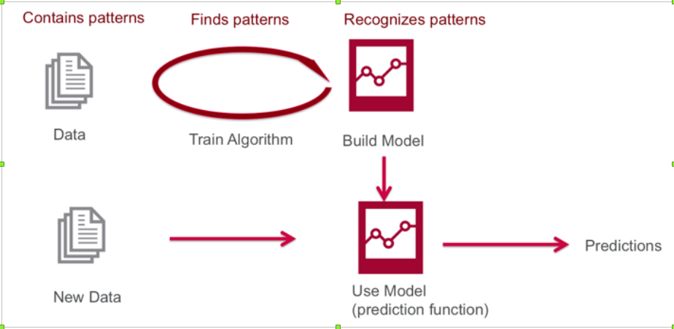
Building Model
Slicing 80% for train and 20% for test
Using past-60 days to predict the next day
Standard Scaling method (Whole dataset):
StandardScaler
MinMaxScaler
LSTM stacking layer of 2 and 50 units each
Epochs = 20 and batch size = 16

Slide 10
Evaluation of model
 | MinMaxScaler | StandardScaler
Adjusted-R-Squared | 0.95 | 0.95
Mean Absolute Percentage Error | 0.017 | 0.017
Max Absolute Percentage Error | 0.1 | 0.1
Min Absolute Percentage Error | 3.09e-05 | 0.00016

Slide 11
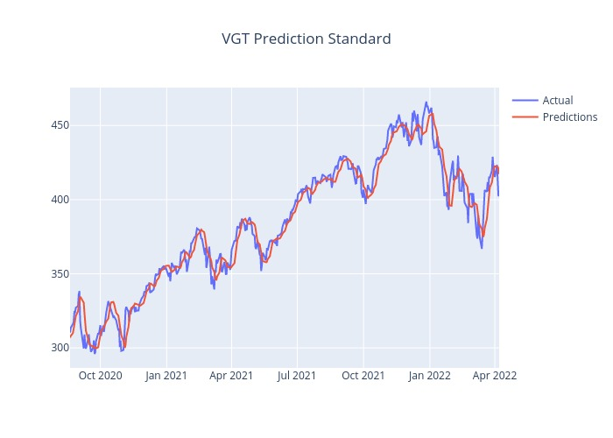

Prediction against Actual Plot

Slide 12

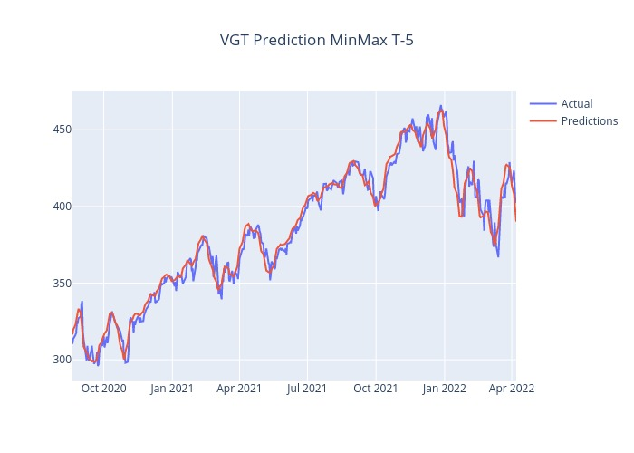
Plot of Shifting the prediction (T-5)
‘Predicted values’ are based past price movement

Slide 13
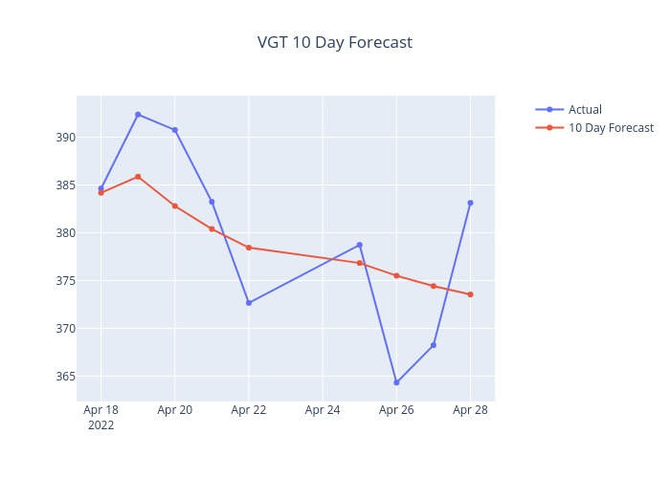
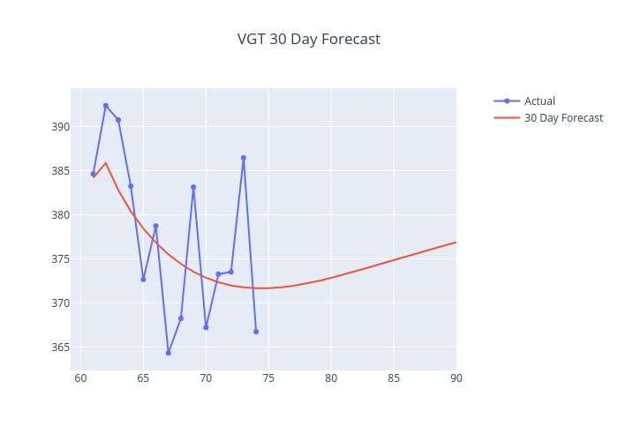
Forecasting Plot
What is this line?

Slide 14
Extrapolation
Extrapolation is defined as an estimation of a value based on extending the known series or factors beyond the area that is certainly known.
Under LSTM, the extrapolation tends to move linearly.
The extrapolation depends on the model not the data.
Extrapolation

Slide 15
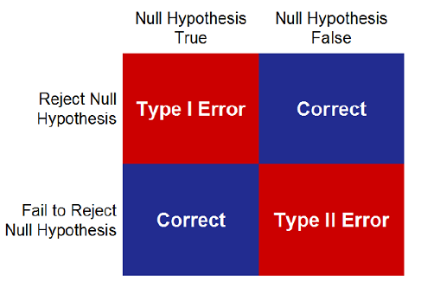
Conclusion to the Hypothesis Testing
Reject Null Hypothesis.
Reason:
The predicted stock price is based on past price movement
Stock price cannot be forecasted due to the forming of extrapolation line.

Slide 16
Why Stock data is/not Predictable?
For Time series to be predictable, the data set must be stationary and normal distribution.
A stationary time series is one whose properties do not depend on the time at which the series is observed. Thus, time series with trends, or with seasonality, are not stationary — the trend and seasonality will affect the value of the time series at different times.
Normal Distribution is an important concept in statistics and the backbone of Machine Learning.
is a continuous probability distribution. It has a bell-shaped curve that is symmetrical from the mean point to both halves of the curve.
Properties:
The mean, mode and median are all equal.
The curve is symmetric at the center (i.e. around the mean, μ).
Exactly half of the values are to the left of center and exactly half the values are to the right.
The total area under the curve is 1.

Slide 17
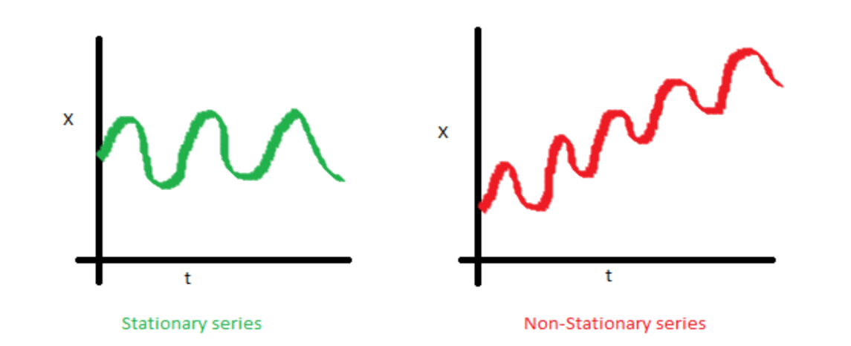
Test for Stationarily
Augmented Dickey-Fuller Test (ADF Test)
A common statistical test used to test whether a given Time series is stationary or not
For non-stationary, statistic test value > critical value and p-value > significant value(0.05)
For stationary, statistic test value and p-value are very low than critical value and significant value (0.05)
Note: The significant value can be any values (0 – 1) depends on the confident level

Slide 18
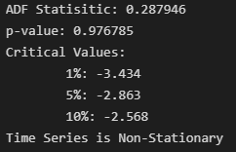
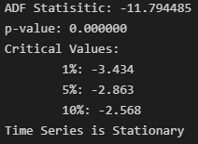
Test for Stationarily
Input the VGT’s Close values into the ADF:
Possible to convert non-stationary to stationary?
Yes. Using Differencing.
Result:

Slide 19
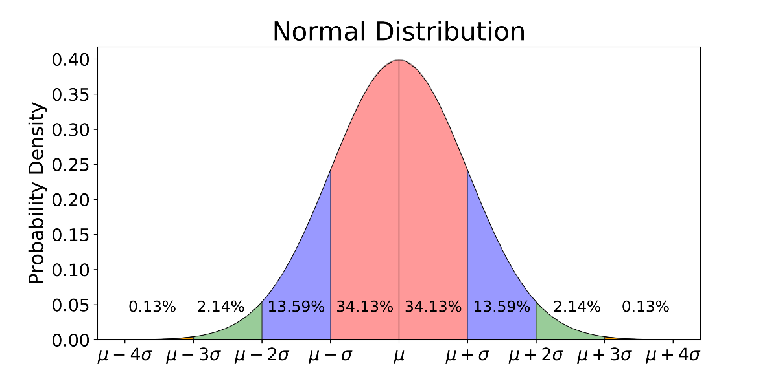
Test for Normal Distribution
Percentage Change
Log Transformation
Hypothesis Testing Library
Kolmogorov Smirnov test (ks-test)
Shapiro Wilk test

Slide 20
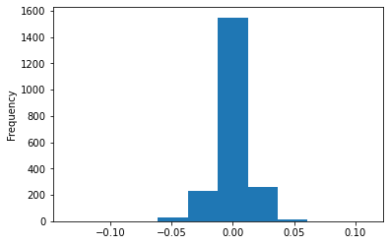
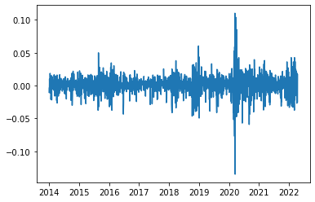
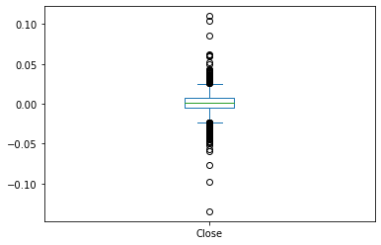
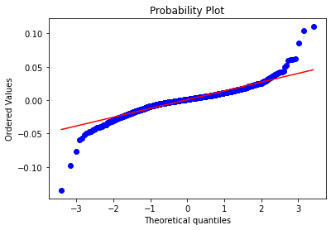

Test for Normal Distribution
Percentage Change:

Slide 21
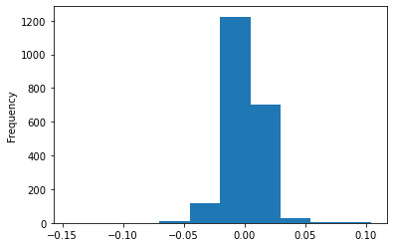
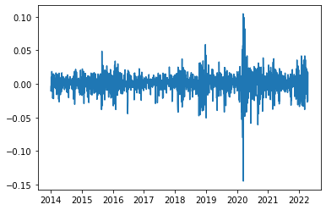
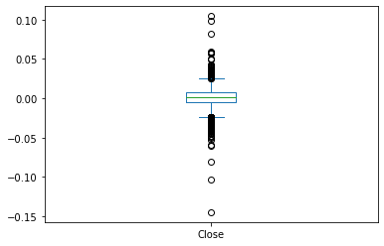
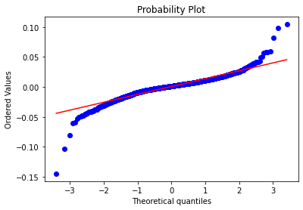

Test for Normal Distribution
Log Transformation:

Slide 22

Test for Normal Distribution
Kolmogorov Smirnov Test (ks-test)
it is commonly used as a test for normality to see if your data is normally distributed. It’s also used to check the assumption of normality in Analysis of Variance.
the test compares a known hypothetical probability distribution (normal distribution) to the distribution generated by data
For Normal distribution, Statistic Value = 0, P-Value > set significant value (0.05)
Note: The significant value can be any values (0 – 1) depends on the confident level
Result:

Slide 23
Test for Normal Distribution
Shapiro Wilk test
Stats Model developed specifically only for normal distribution.
For Normal distribution, Statistic Value = 0, P-Value > set significant value
Note: The significant value can be any values (0 – 1) depends on the confident level
Result:

Slide 24

Difficulties and Take-away
Difficulties:
Too much misinformation regards to the usage of LSTM
Take-away:
Stock data is not predictable
Reason are due to the nature of the data
Not Stationary
Not Normal Distribution

Slide 25
THE END

Slide 26
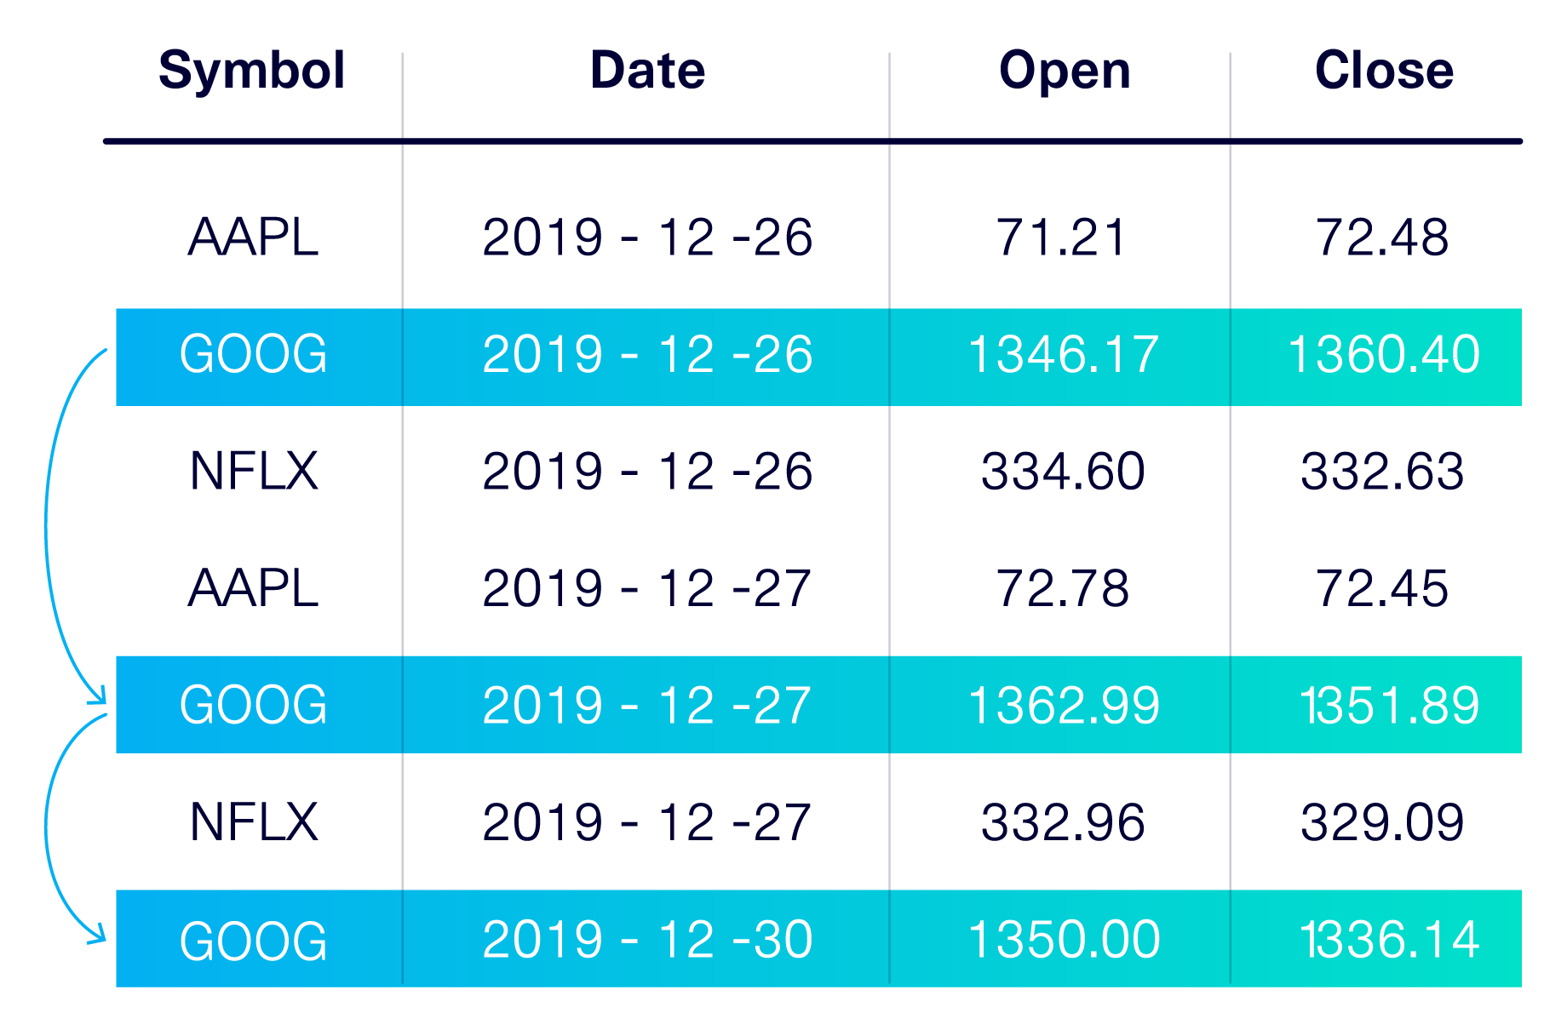

What is sequential data?
Whenever the points in the dataset are dependent on the other points in the dataset the data is said to be Sequential data. A common example of this is a Timeseries such as a stock price or a sensor data where each point represents an observation at a certain point in time

